Slide 1
23I412 - EMBEDDED SYSTEM DESIGN LABORATORY
MINI PROJECT ON
SMART PARKING SYSTEM

Slide 2
INTRODUCTION
A Smart Parking System is an automated system that uses sensors and embedded technology to monitor and manage parking spaces.
It helps users quickly locate available parking spots and provides real-time information through digital displays or mobile apps.
The system uses components like Raspberry Pi Pico, IR sensors, Servo motor, RGB LED, Buzzers and display to detect vehicle presence and update slot status automatically.

Slide 3
WHY SMART PARKING IS NEEDED?
Traditional parking systems face several issues:
Time Waste: Drivers spend a lot of time looking for available spaces.
Traffic Congestion: Increased vehicle movement inside parking lots leads to unnecessary traffic.
Fuel Consumption: Vehicles burn fuel while circling around to find a spot.
Manual Supervision: Requires human staff to guide and monitor vehicles.
Inefficient Space Use: Slots may be left empty because availability isn’t clearly shown to users.

Slide 4
Basic System Overview
Car detected at entry by IR sensor
If slot available → Gate opens, green LED, single beep
If full → Gate stays closed, red LED, double beep
Car exit detected → Gate opens, blue LED, slot count increases
Slot count updates in real time automatically

Slide 5
Block Diagram
Main Components :
IR Sensors → Detect car movement
Raspberry Pi Pico → Controls logic and components
Servo Motor → Opens/closes gate
RGB LED → Shows slot status
Buzzer → Gives alerts

Slide 6
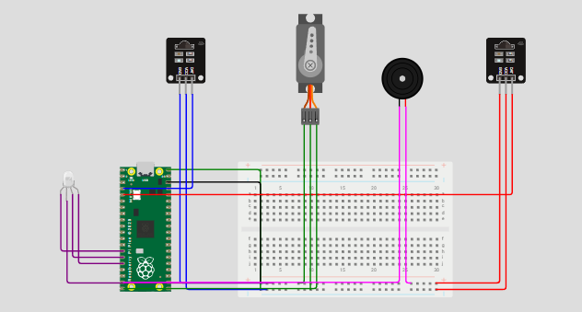

Slide 7
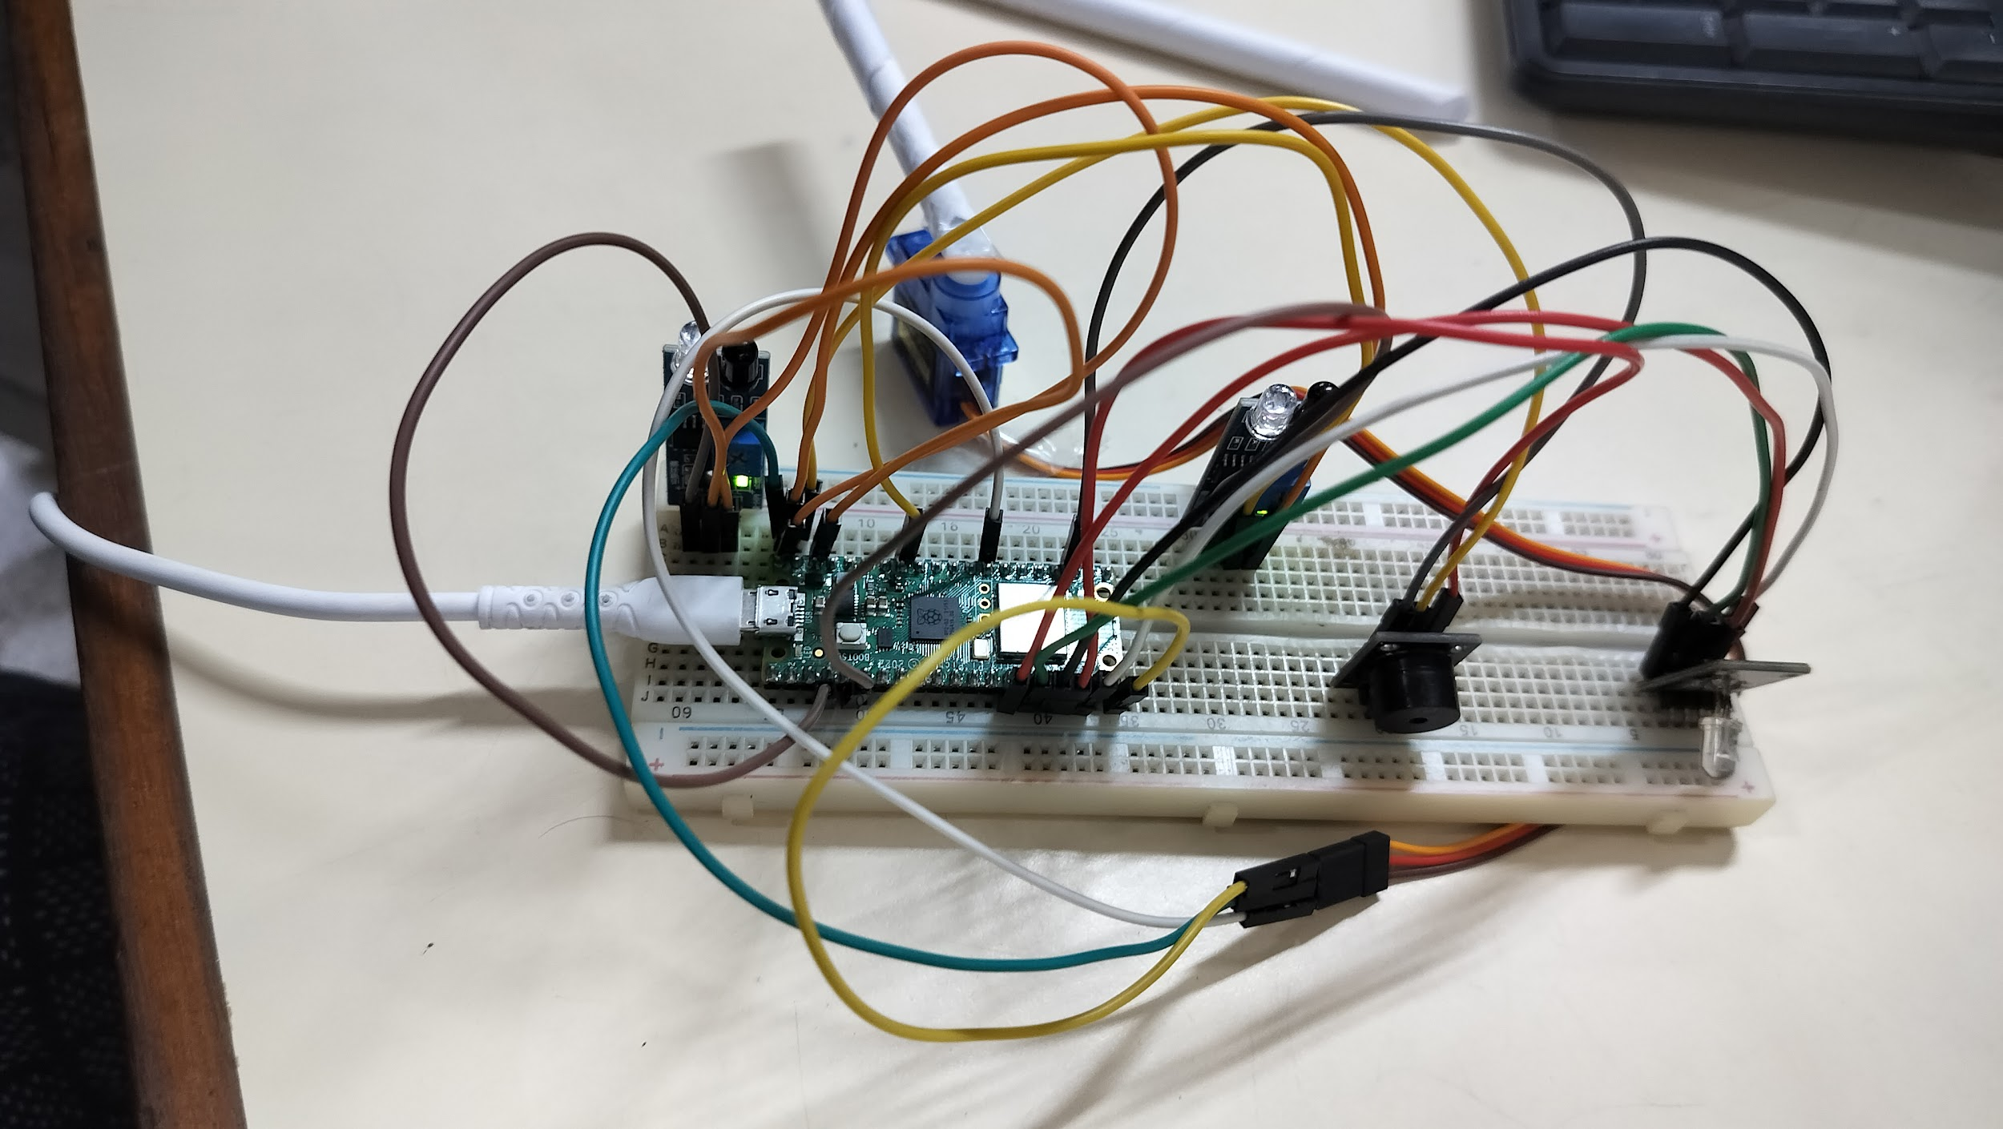

Slide 8
List of Components
Raspberry Pi Pico – Microcontroller
IR Sensors (2x) – Entry & exit detection
Servo Motor – Gate control
RGB LED – Indicates status (Green, Red, Blue)
Buzzer – Beep feedback
Power Supply – 5V USB or battery

Slide 9
Algorithm:
Entry Flow:
1. Check IR1 (entry sensor)
2. If IR1 detects a car and a slot is available:
Green light turns on
Buzzer gives a short beep
Gate opens via servo
Waits 2 seconds
Gate closes
Slot count decreases by 1
Exit Flow:
1. Check IR2 (exit sensor)
2. If IR2 detects a car:
Blue light turns on
Buzzer gives a short beep
Gate opens
Waits 2 seconds
Gate closes
Slot count increases by 1 (unless already at full capacity)

Slide 10
3. Sensor Logic and State Management
The two IR sensors are used as digital input pins. When a car breaks the beam, the sensor reads LOW (0).
We use flags like car_entering and car_exiting to avoid multiple triggers while a car is still present.
The servo motor angle is controlled using PWM — a duty cycle is calculated based on the desired angle (0° = open, 90° = closed).
Slot management is done using a simple variable slots, which keeps the count of available parking spaces.
4. User Feedback
Visual Feedback via RGB LED:
Green – Entry allowed
Red – Parking Full
Blue – Car Exiting
Off – Idle
Audio Feedback via Buzzer:
Short beep – Entry/exit success
Double beep – Entry denied due to full parking

Slide 11
1.IR SENSOR SETUP:
IR1 = Pin(2, Pin.IN) # Entry sensor
IR2 = Pin(3, Pin.IN) # Exit sensor
2.SERVO MOTOR FOR GATE:
servo = PWM(Pin(15))
servo.freq(50)
def set_servo_position(angle):
duty = int(1638 + (angle / 180) * (8192 - 1638))
servo.duty_u16(duty)
3.MAIN LOOP :
while True:
if IR1.value() == 0 and not car_entering:
if slots > 0:
set_servo_position(GATE_OPEN)
slots -= 1
else:
rgb_led(1, 0, 0) # Red

Slide 12
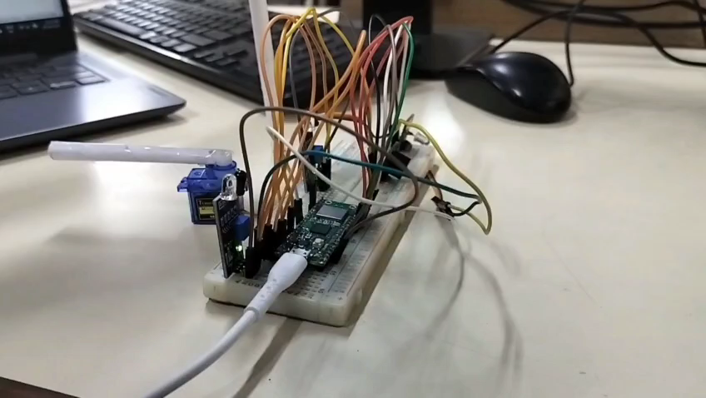
OUTPUT :

Slide 13
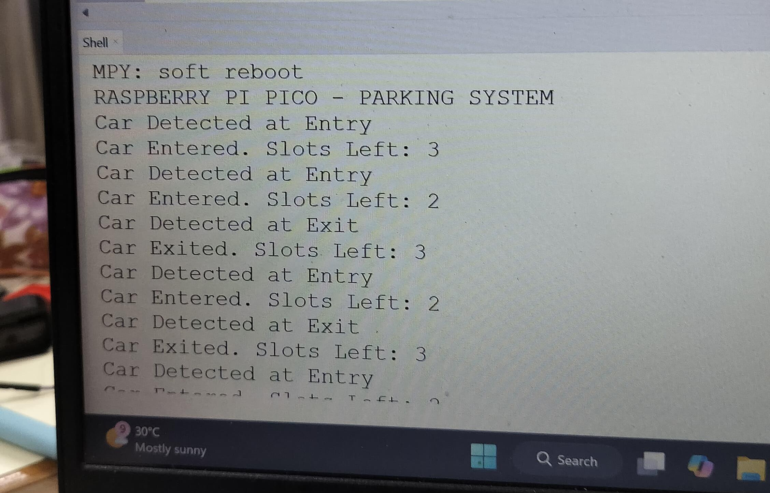

Slide 14
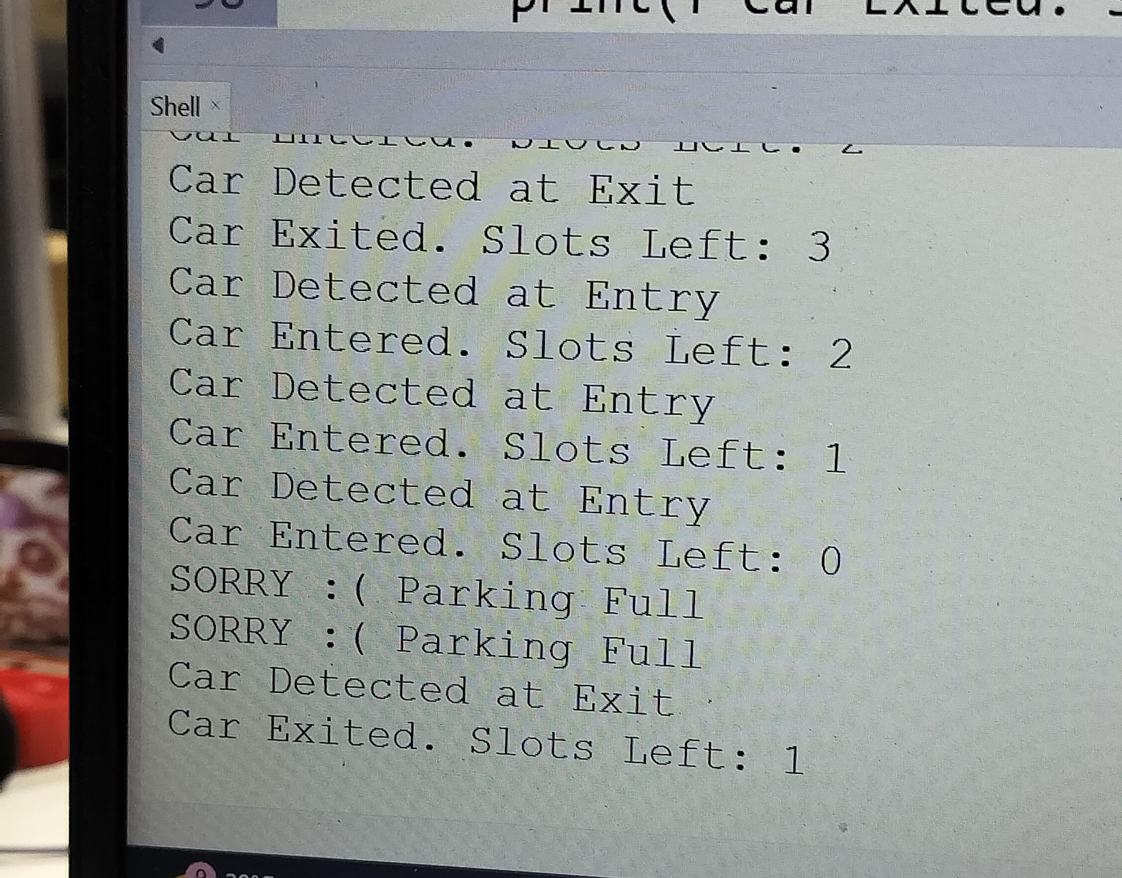

Slide 15
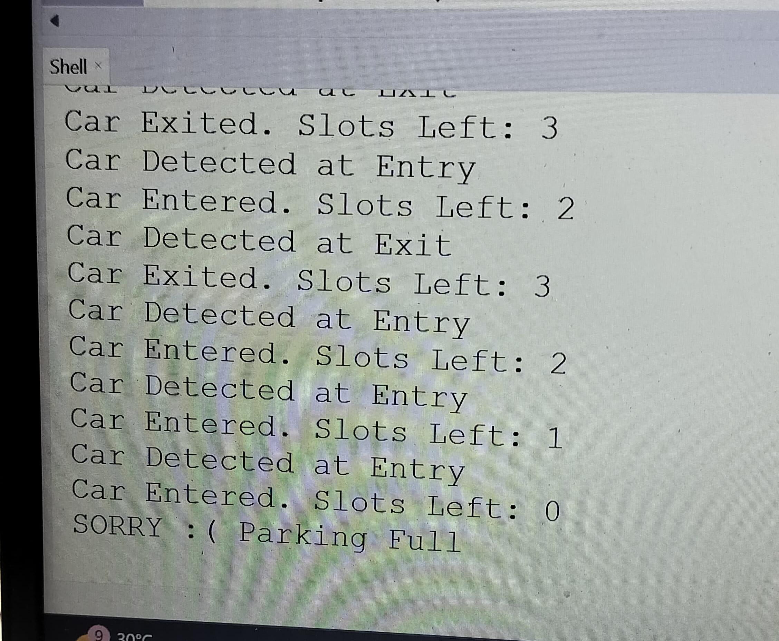

Slide 16
Result
System successfully detects and tracks vehicle
Accurate gate control and slot management
Audio feedback using buzzer works efficiently

Slide 17
APPLICATIONS
Automated Parking Management
Automatically detects available parking slots.
Real-Time Slot Monitoring
Uses ultrasonic/IR sensors to detect the presence or absence of a vehicle in a parking slot.
Displays real-time slot status
Cost-Effective and Scalable
Raspberry Pi Pico makes the system affordable for small parking lots, residential areas, schools, and offices.

Slide 18
FUTURE SCOPE OF SMART PARKING SYSTEM
Expansion to More Parking Slots
The system can be scaled to monitor 10, 20, or more slots by using additional sensors
2. Integration with IoT (Internet of Things)
Monitor parking availability via mobile apps or websites.
Data storage and analytics (track usage patterns).
3. Voice Assistant Integration
4. Smart Billing or Payment System

Slide 19
THANK YOU

